Slide 1

Lecture
on
“Advanced Computer Architecture –TCS 704”
by
Akansha Gupta
DEPARTMENT OF COMPUTER SCIENCE AND ENGINEERING
GRAPHIC ERA DEEMED TO BE UNIVERSITY – 248002

Slide 2
MESSAGE PASSING VS
SHARED MEMORY

Slide 3
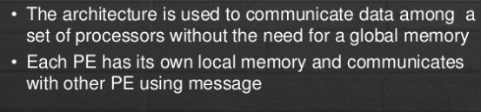
Message Passing-Introduction

Slide 4
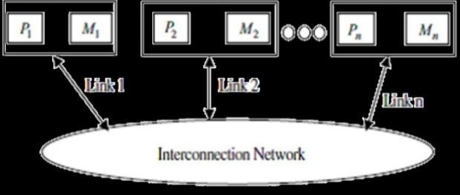

Slide 5
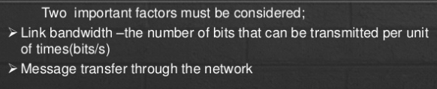
MP Network

Slide 6
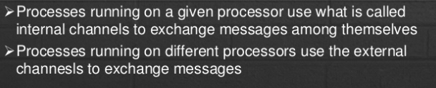
Process Communication

Slide 7
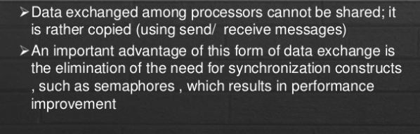
Data Exchanged

Slide 8
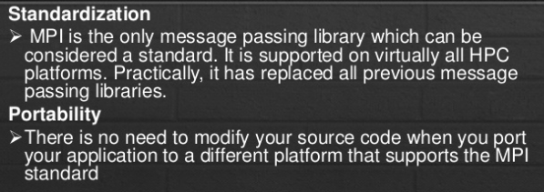
Message-Passing Interface-MPI

Slide 9
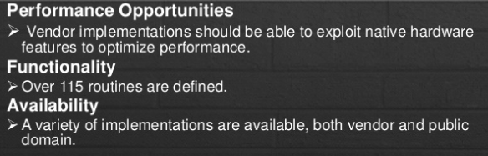
Message-Passing Interface-MPI

Slide 10
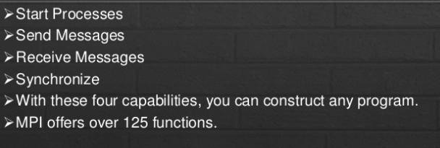
MPI Basics

Slide 11
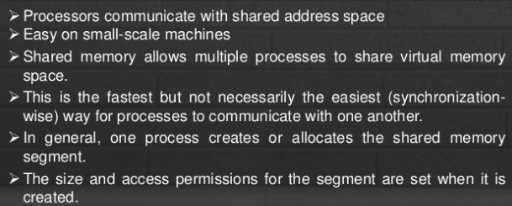
Shared Memory- Introduction

Slide 12
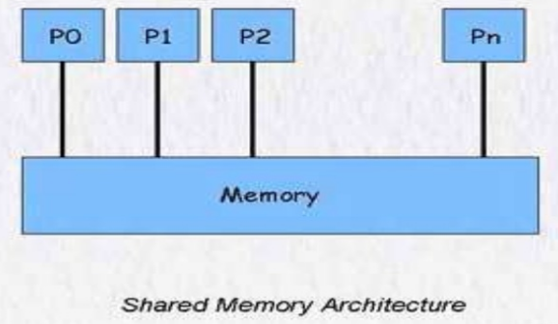

Slide 13
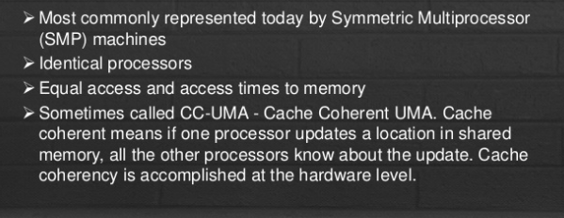
Uniform Memory Access(UMA)

Slide 14
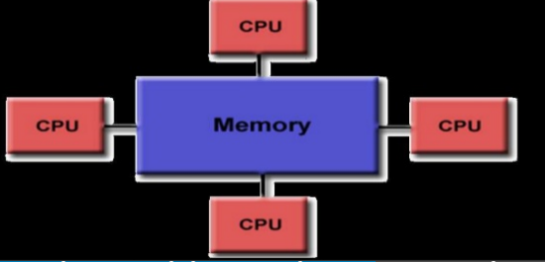
Shared Memory(UMA)

Slide 15
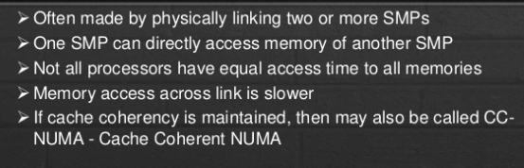
Non- Uniform Memory Access(NUMA)

Slide 16
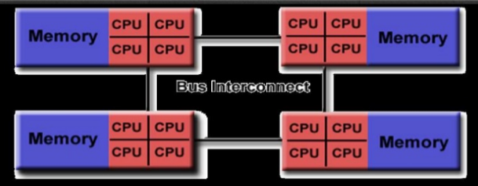
Shared Memory(NUMA)

Slide 17
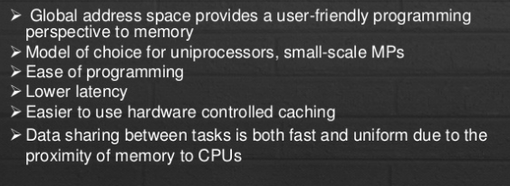
Advantages

Slide 18
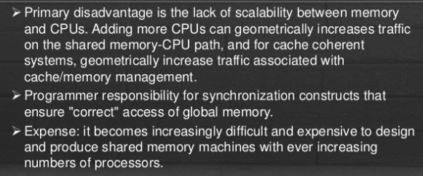
Disadvantages

Slide 19
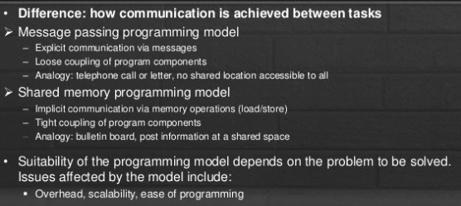
Message Passing Vs Shared Memory

Slide 20
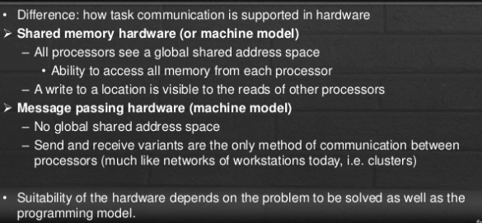
Message Passing Vs Shared Memory Hardware

Slide 21
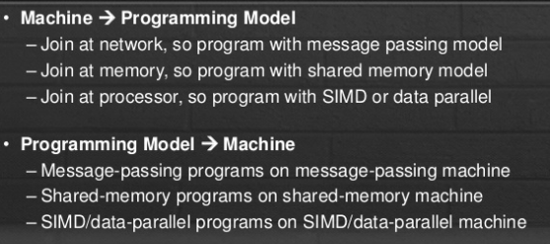
Programming Model Vs Architecture

Slide 22
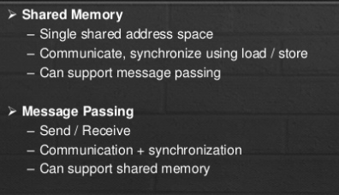
Separation Model and Architecture

Slide 23
https://youtu.be/qvx0LckQa2A
THANKS

